Slide 1
Workshop on Distributed computing
ARCTIC

Slide 2
Agenda
What is deep learning? What is happening in the world?
The Deep Learning Process
Writing a single gpu program for deep learning
Why Distributed Parallel Programming is needed
Scaling of LLM like structures
Data Parallelism
Multi GPU Programming
Multi Node Programming
Running your code in ARCTIC multi node
More on distributed training - Model Parallel

Slide 3
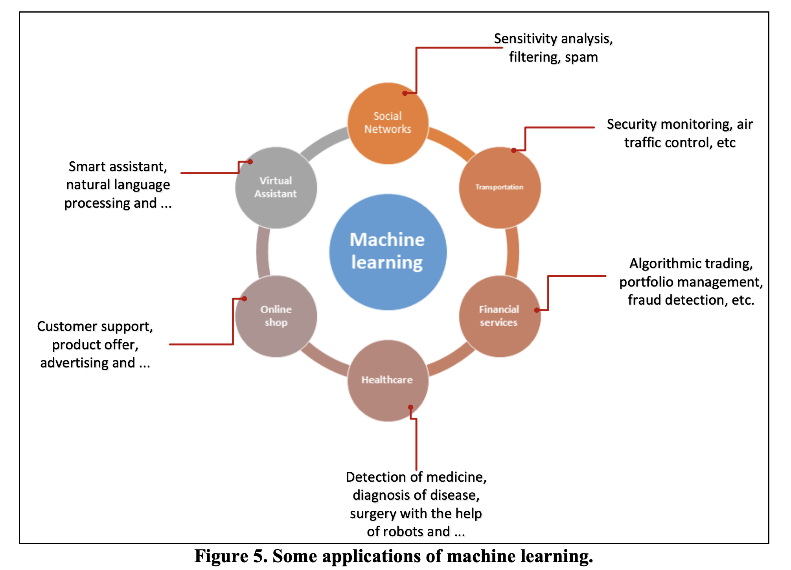
What is deep learning? What is happening in the world?

Slide 4
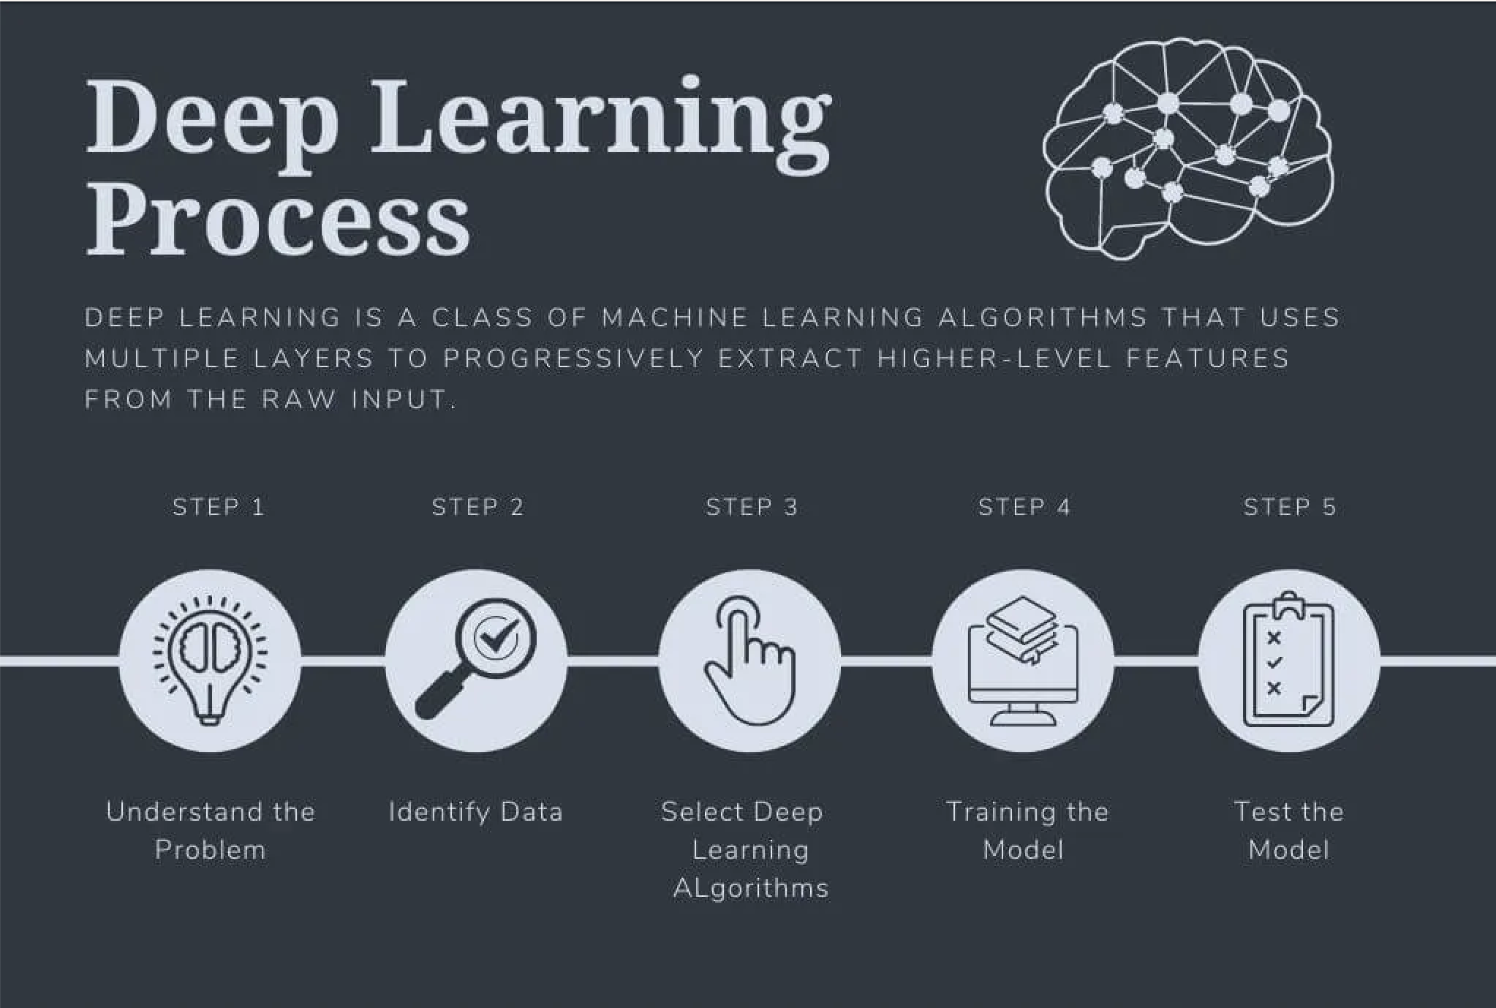
2. The Deep Learning Process

Slide 5
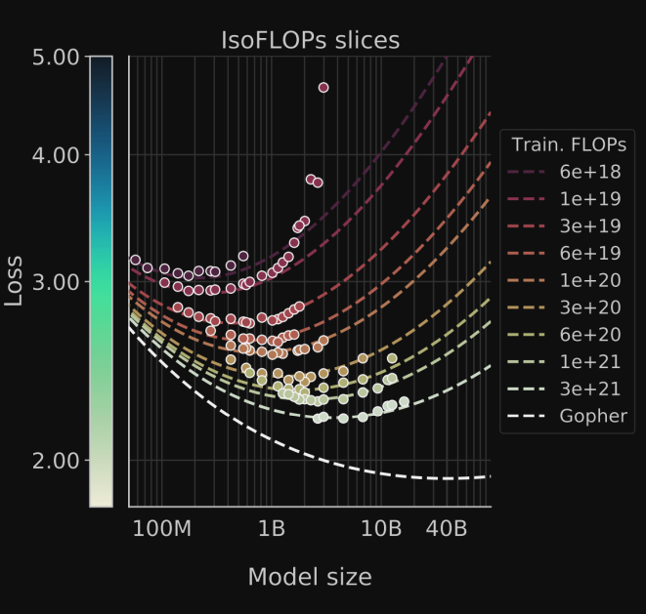
3. Scaling of LLM
For LLMs that have been designed to scale well
(avoiding overfitting and vanishing gradients, for example),
we find that performance is a predictable function of:
The dataset size
The number of parameters as these curves show no
signs of ending yet.
Overall, the graph conveys how model performance
(loss) improves with increasing model size and computational
resources,floating-point operations per second , (FLOPs), and how
specific benchmarks or models fit within this landscape.

Slide 6
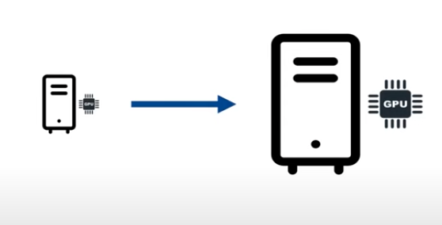
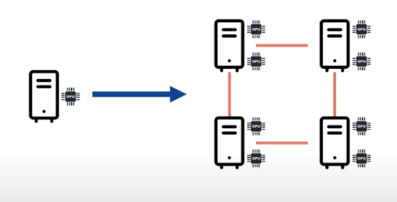
Types of Scaling
Vertical scaling
Horizontal scaling

Slide 7
4. Why Distributed Parallel Programming is needed
Training deep learning models takes time.
Deep neural networks often consist of millions or billions of parameters that are trained over huge datasets.
As deep learning models become more complex, computation time can increase.
Training a model on a single GPU can take weeks.
Distributed training can fix this problem.
As its name suggests, distributed training distributes training workloads across multiple mini-processors.
These mini-processors, referred to as worker nodes, work in parallel to accelerate the training process.
Their parallelism can be achieved by data parallelism or model parallelism.
In summary:
Saves time
Increase the amount of compute
Helps train models faster
The models can be larger and larger and be harder to fit in a single GPU

Slide 8
3. Writing a single gpu program for deep learning
https://github.com/arctic-gsu/ddp-workshop/blob/main/single_gpu.py

Slide 9
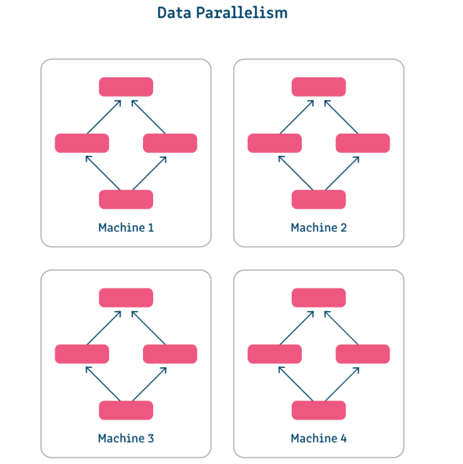
6. Data Parallelism
It would be better if we could use a lot of GPUs for the training step.
One technique to achieve this is to use Data Parallelism so that
each GPU trains on a separate batch of data.
At the end of that batch we average the collective wisdom of all
of these GPUs to arrive at our new and improved parameters.

Slide 10
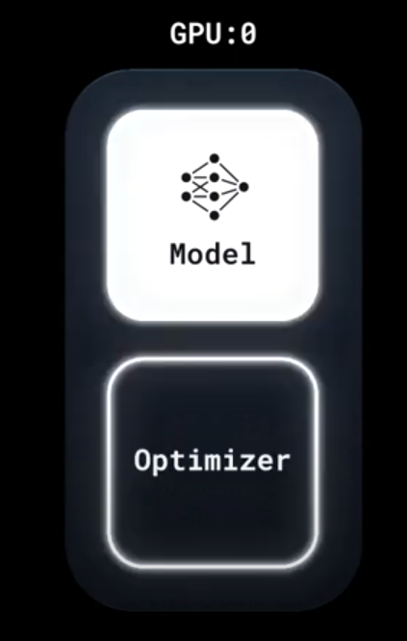
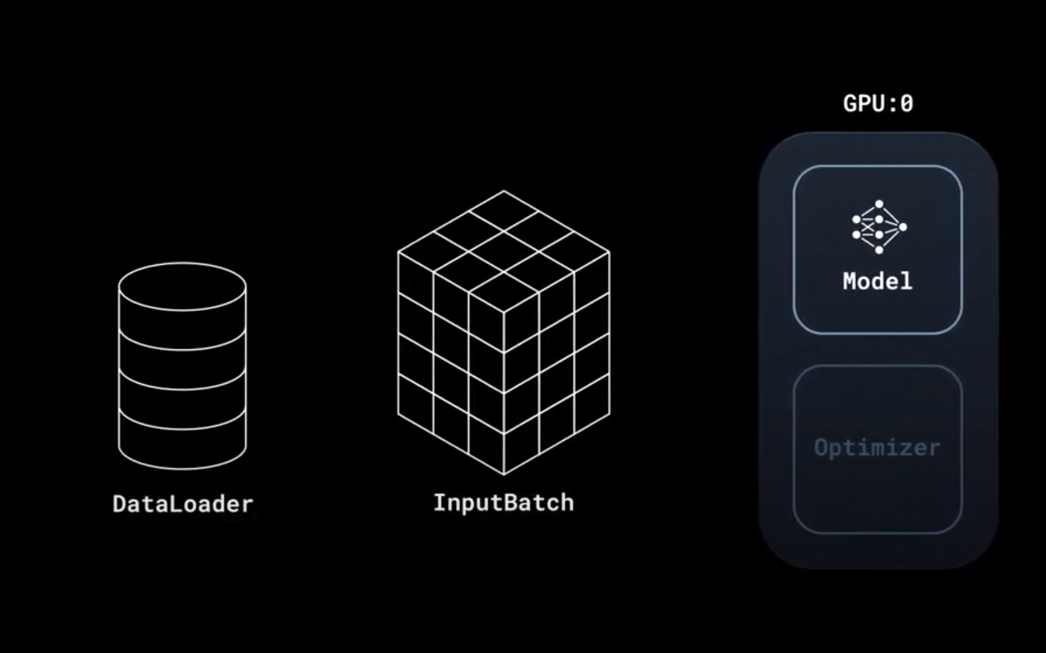
Visual of what happens while training

Slide 11
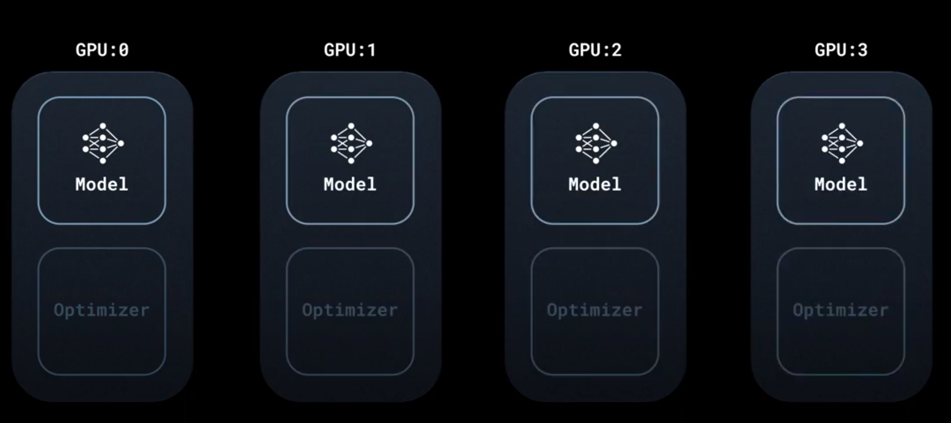
When we use 4 gpu
DDP launches 1 process per gpu
Each machine has its own replica
of the model and optimizers - all replicas identical
Not only initial parameters but the intermittent
parameters are also the same
DDP maintains synchronization throughout
the training process.

Slide 12
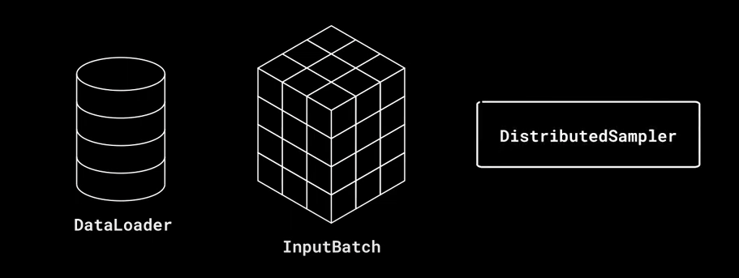
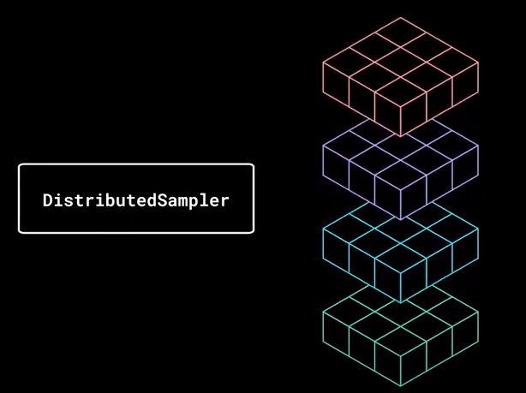
Distributed Sampler
In PyTorch, a DistributedSampler is specifically designed for distributed training, helping to manage how datasets are split and distributed across multiple processes or GPUs.
It's part of PyTorch's torch.utils.data module, which includes various utilities for data loading, transforming, and batching, essential for training deep learning models.
The DistributedSampler is used when you are training a model in a distributed fashion, meaning the training process is spread out over multiple GPUs or even across multiple nodes in a network. This approach allows for significantly faster training times by parallelizing the computation. We are now concurrently processing 4 times the data compared to 1 gpu

Slide 13
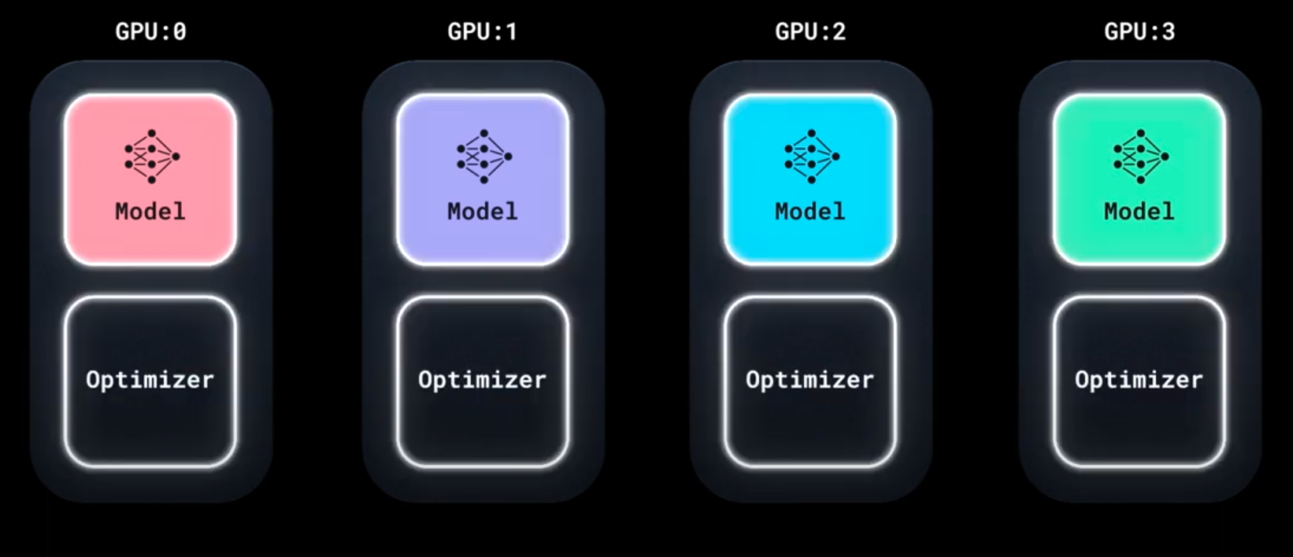
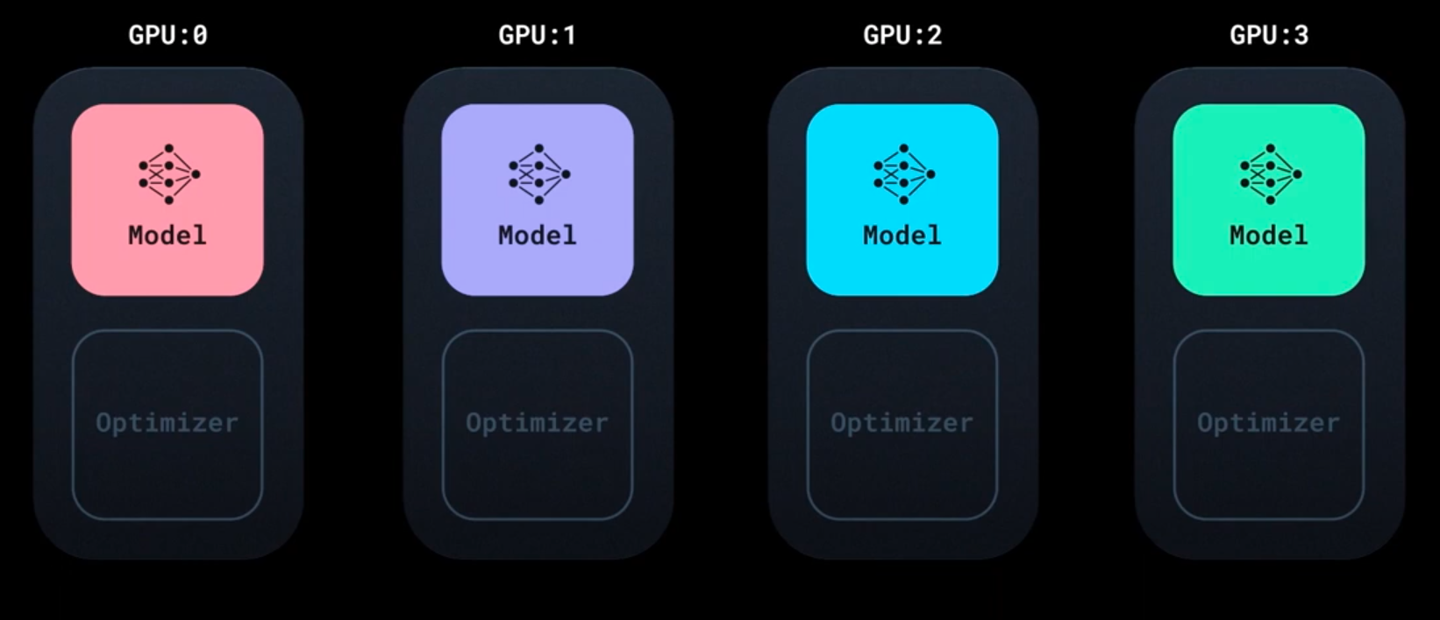
Distributed Data Parallel
Now all these 4 machines have 4 different gradients as they processed 4 different batches of data.
Running an optimizer at this step means all machine will load with different gradients and this will have lead to 4 different models.

Slide 14
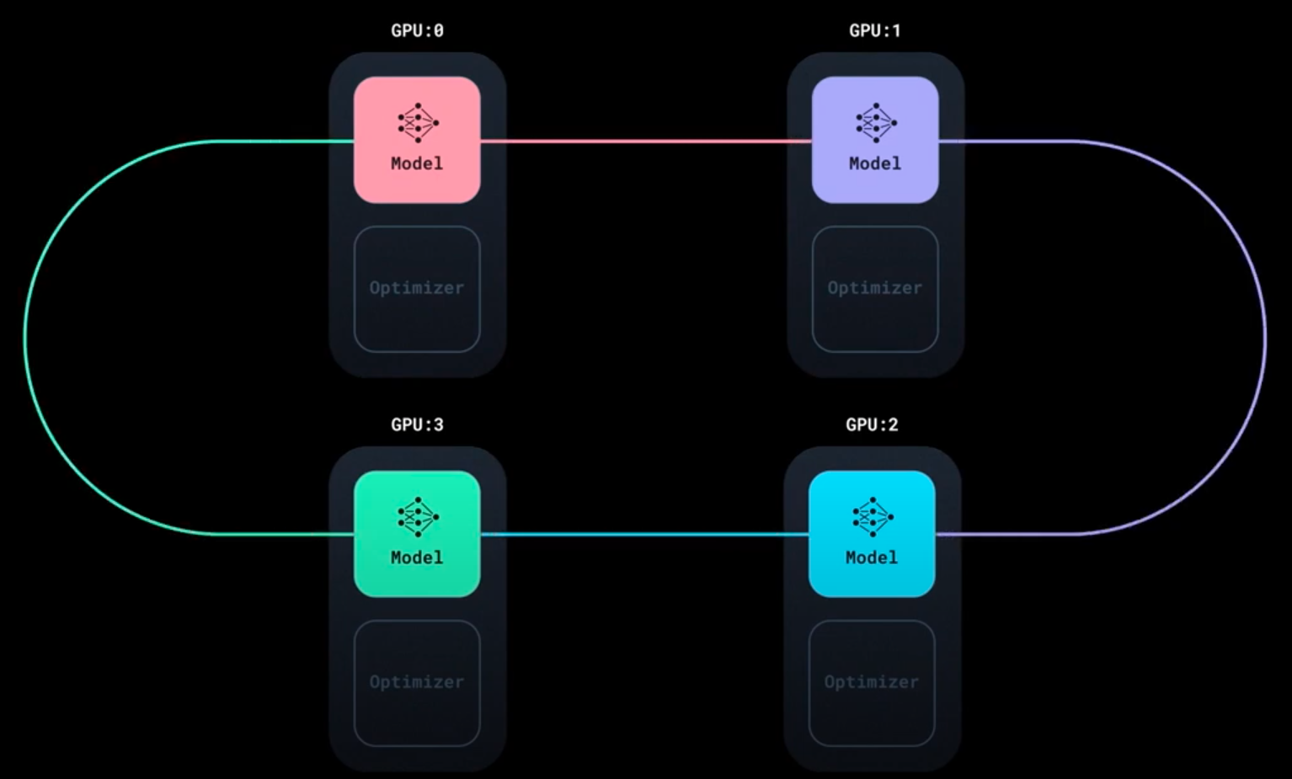
Distributed Data Parallel
Now DDP, initiates a all reduce algorithm where synchronizes all the gradients of all machines. This communication happens when GPU computation is running, ensuring GPU does not become idle while communication is happening.
After this, all model has same same gradients and running optimizer now updates all replica parameter to same value
So when we started, all model replicas were identical
and at last all replica remain same.
This completes one iteration, and all machines are
ready for running another iteration

Slide 15
7. Multi GPU
https://github.com/arctic-gsu/ddp-workshop/blob/main/multi_gpu.py

Slide 16
8. Multi node
https://github.com/arctic-gsu/ddp-workshop/blob/main/multinode.py

Slide 17
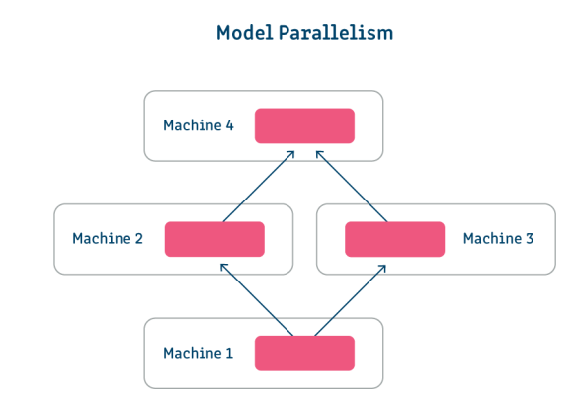
10. More on distributed training - Model Parallel
In most cases, data parallelism is relatively straightforward and efficient;
However, there are times when the model is so large it cannot fit on a single worker node.
This is where model parallelism comes in.
In model parallelism, the model itself is divided into parts that are
trained simultaneously across different worker nodes.
All workers use the same data set, and they only need to share
global model parameters with other workers—typically
just before forward or backward propagation.
This type of distributed training is much more difficult to
implement and only works well in models with
naturally parallel architectures, such as those with multiple
branches.

